Slide 1
CSCI 1101 Intro to Computers
7.3 Learning HTML

Slide 2
What are Frames?
Frames allow independent navigation and content to two (or more) locations on a single browser screen
Frames allow multiple "windows" in a single browser page

Slide 3
Advantages / Disadvantages of Frames
Advantages
  Allow multiple content on a single page
  Allow linked content (such as a table of contents)
  Allow separate scrollable regions on a page
Disadvantages
  Breaks down the traditional 1 file equals 1 web-page linkage
  Adds considerable complexity to the coding process
  Implementation is fairly browser specific
  Errors can be extremely difficult to identify

Slide 4
Basics of Frame Design - content of frame1.htm file
<HTML>
<HEAD><TITLE>Frame example</TITLE></HEAD>
<FRAMESET ROWS="100,*">
<FRAME NAME="top_row" SRC="frame1top.htm">
<FRAME NAME="bottom_row" SRC="frameintro.htm">
</FRAMESET>
</HTML>

Slide 5
Basics of Frame Design - content of frame1.htm file
<HTML>
<HEAD><TITLE>Frame example</TITLE></HEAD>
<FRAMESET ROWS="100,*">
<FRAME NAME="top_row" SRC="frame1top.htm">
<FRAME NAME="bottom_row" SRC="frameintro.htm">
</FRAMESET>
</HTML>
Notice - there is NOT a <BODY> … </BODY> tag set in the frame definition. This is NOT a mistake in the example code.

Slide 6
Basics of Frame Design -
Defining the frameset
<HTML>
<HEAD><TITLE>Frame example</TITLE></HEAD>
<FRAMESET ROWS="100,*">
<FRAME NAME="top_row" SRC="frame1top.htm">
<FRAME NAME="bottom_row" SRC="frameintro.htm">
</FRAMESET>
</HTML>
The Frameset tags define that this frame will have two rows.
The top row will be 100 pixels tall, the second row will receive whatever space remains.

Slide 7
Basics of Frame Design
Defining the top row
<HTML>
<HEAD><TITLE>Frame example</TITLE></HEAD>
<FRAMESET ROWS="100,*">
<FRAME NAME="top_row" SRC="frame1top.htm">
<FRAME NAME="bottom_row" SRC="frameintro.htm">
</FRAMESET>
</HTML>
The FRAME tags define the two rows of the frame.
The name entry is technically optional, but highly recommended. The SRC tag defines the content of the frame when the frameset is initially loaded.

Slide 8
Content of frame1top.htm file
<HTML>
<HEAD><TITLE>This is the top row content</TITLE></HEAD>
<BODY bgcolor="#FFFF10">
<CENTER>
<P><FONT size="+2" color="#299C39">
This is the top row of the frame<BR></FONT>
<A HREF="framecontent1.htm" TARGET="bottom_row">
Link #1</A>&nbsp;&nbsp;
<A HREF="framecontent2.htm" TARGET="bottom_row">
Link #2</A>&nbsp;&nbsp;
<A HREF="framecontent3.htm" TARGET="bottom_row">
Link #3</A>&nbsp;&nbsp;
<A HREF="frameintro.htm" TARGET="bottom_row">
Return to Original</A><BR>
Notice how clicking on each link changes the content in
the bottom frame,<BR>
without changing anything in the top.</P></CENTER>
</BODY>
</HTML>

Slide 9
Basics of Frame Design
Defining the bottom row
<HTML>
<HEAD><TITLE>Frame example</TITLE></HEAD>
<FRAMESET ROWS="100,*">
<FRAME NAME="top_row" SRC="frame1top.htm">
<FRAME NAME="bottom_row" SRC="frameintro.htm">
</FRAMESET>
</HTML>
This Frame tag defines the bottom of the browser window, which will be the "large size" window on the screen.
The name entry (bottom_row) shows up in links in the frame1top.htm file.
The initial content of the is defined in the SRC tag entry.

Slide 10
Content of frameintro.htm file
<HTML>
<HEAD><TITLE>This is the introduction content
</TITLE></HEAD>
<BODY bgcolor="#52B552">
<CENTER>
<P><FONT SIZE="+3" color="#FFFF42">
After completing your team project, <BR>
I thought you might enjoy this graphic<P>
<IMG SRC="images/dilbert_team_player.gif"
ALT="A Dilbert Cartoon on Teams"><BR>
</P>
</BODY>
</HTML>

Slide 11
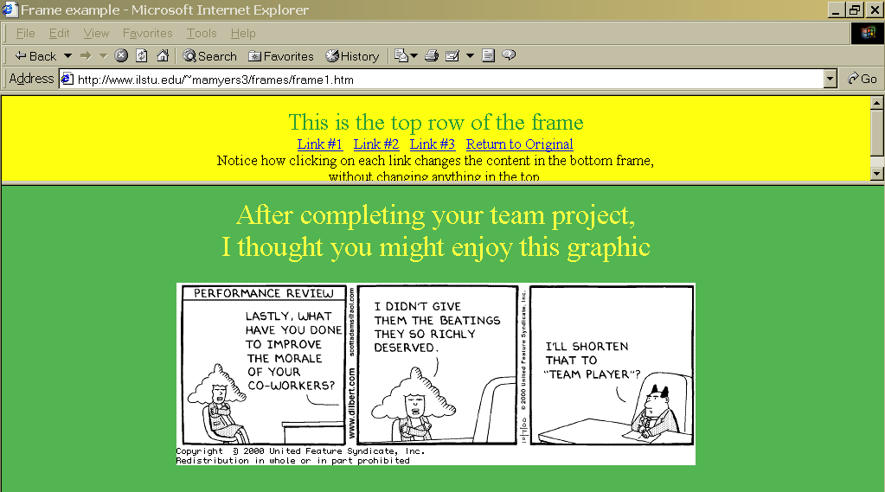
Opening of frame page

Slide 12
How the links in frame1top.htm function
{content removed for space purposes}
This is the top row of the frame<BR></FONT>
<A HREF="framecontent1.htm" TARGET="bottom_row">
Link #1</A>&nbsp;&nbsp;
<A HREF="framecontent2.htm" TARGET="bottom_row">
Link #2</A>&nbsp;&nbsp;
<A HREF="framecontent3.htm" TARGET="bottom_row">
Link #3</A>&nbsp;&nbsp;
<A HREF="frameintro.htm" TARGET="bottom_row">
Return to Original</A><BR>
{content removed for space purposes}
The link has the HREF="…" entry we have used earlier this semester.
The new item is the TARGET="bottom_row" entry.
The TARGET name references the FRAME name defined in the original frameset definition.

Slide 13
Basics of Frame Design - content of frame1.htm file
<HTML>
<HEAD><TITLE>Frame example</TITLE></HEAD>
<FRAMESET ROWS="100,*">
<FRAME NAME="top_row" SRC="frame1top.htm">
<FRAME NAME="bottom_row" SRC="frameintro.htm">
</FRAMESET>
</HTML>
This name is referenced in the links defined in
The frame1top.htm file.

Slide 14
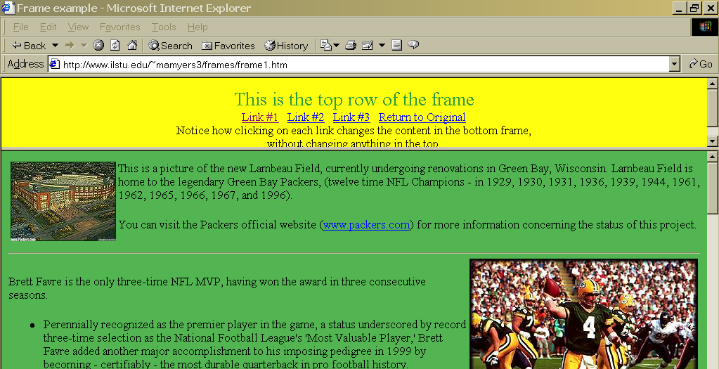
Visiting Link #1

Slide 15
Defining a frameset with columns instead of rows.
<HTML>
<HEAD><TITLE>Frame example - Columns</TITLE></HEAD>
<FRAMESET COLS="200,*">
<FRAME NAME="left_side" SRC="frame2menu.htm"
SCROLLING="yes">
<FRAME NAME="right_side" SRC="frameintro.htm"
SCROLLING="yes">
</FRAMESET>
</HTML>

Slide 16
The substantive changes are highlighted.
<HTML>
<HEAD><TITLE>Frame example - Columns</TITLE></HEAD>
<FRAMESET COLS="200,*">
<FRAME NAME="left_side" SRC="frame2menu.htm"
SCROLLING="yes">
<FRAME NAME="right_side" SRC="frameintro.htm"
SCROLLING="yes">
</FRAMESET>
</HTML>

Slide 17
Left-side menu content of frame2menu.htm file
<HTML>
<HEAD>
<TITLE>This is the left side content</TITLE>
</HEAD>
<BODY bgcolor="#FFFF10">
<CENTER>
<P><FONT size="+1" color="#299C39">
This is the table of contents listings for the left side frame<BR></FONT>
</CENTER>
{MORE CONTENT ON THE NEXT PAGE}

Slide 18
Left-side content (continued)
<UL>
<LI><A HREF="framecontent1.htm" TARGET="right_side">
Link #1</A><BR>Packer graphics page.</LI>
<LI><A HREF="framecontent2.htm" TARGET="right_side">
Link #2</A><BR>Packer schedule page.</LI>
<LI><A HREF="framecontent3.htm" TARGET="right_side">
Link #3</A><BR>Myerscough Websume Page.</LI>
<LI><A HREF="frameintro.htm" TARGET="right_side">
Return to Original</A><BR>Being a team member</LI>
</UL>
<P>
Notice how clicking on each link changes the content
in the right side frame,<BR>
without changing anything in the left side.</P>
</BODY>
</HTML>

Slide 19
Defining table of contents as a list
<UL>
<LI><A HREF="framecontent1.htm" TARGET="right_side">
Link #1</A><BR>Packer graphics page.</LI>
<LI><A HREF="framecontent2.htm" TARGET="right_side">
Link #2</A><BR>Packer schedule page.</LI>
<LI><A HREF="framecontent3.htm" TARGET="right_side">
Link #3</A><BR>Myerscough Websume Page.</LI>
<LI><A HREF="frameintro.htm" TARGET="right_side">
Return to Original</A><BR>Being a team member</LI>
</UL>
<P>
Notice how clicking on each link changes the content
in the right side frame,<BR>
without changing anything in the left side.</P>
</BODY>
</HTML>

Slide 20
Defining each of the hyperlinks
(Note the target names in each)
<UL>
<LI><A HREF="framecontent1.htm" TARGET="right_side">
Link #1</A><BR>Packer graphics page.</LI>
<LI><A HREF="framecontent2.htm" TARGET="right_side">
Link #2</A><BR>Packer schedule page.</LI>
<LI><A HREF="framecontent3.htm" TARGET="right_side">
Link #3</A><BR>Myerscough Websume Page.</LI>
<LI><A HREF="frameintro.htm" TARGET="right_side">
Return to Original</A><BR>Being a team member</LI>
</UL>
<P>
Notice how clicking on each link changes the content
in the right side frame,<BR>
without changing anything in the left side.</P>
</BODY>
</HTML>

Slide 21
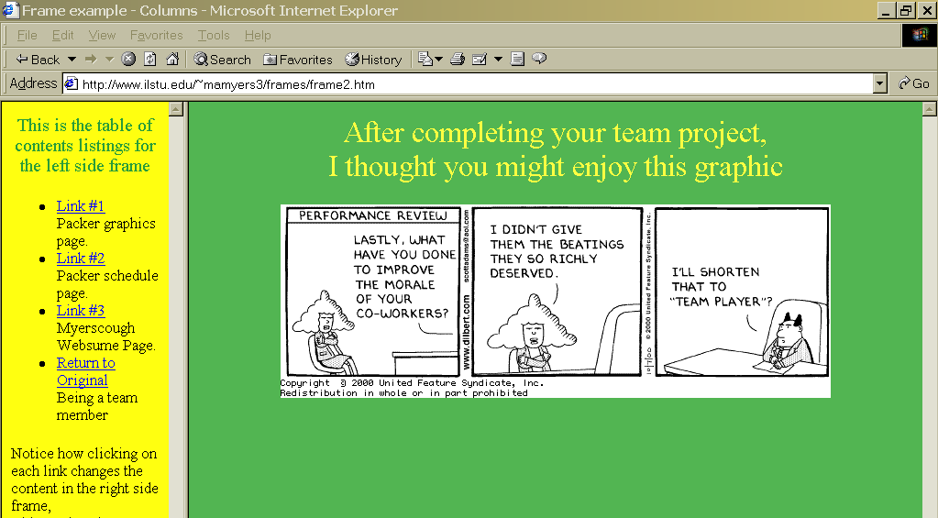
Column-format displayed

Slide 22
Options in defining the framesets
<FRAMESET ROWS="100,*">
Defines a two row frameset, the top row will
be 100 pixels tall, the second row receives
the remaining space on the screen.
<FRAMESET ROWS="1*,4*">
Defines a two row frameset, where the bottom
row will always be 4 times larger than the
top row, regardless of browser window.
http://www.ilstu.edu/~mamyers3/frames/frame3.htm
demonstrates this setting.

Slide 23
More options in defining the framesets
<FRAMESET ROWS="100,*,75">
Defines a three row frameset.
The top row will be 100 pixels tall, the bottom
row will be 75 pixels tall. The middle row will
receive whatever space remains.
<FRAMESET ROWS="200,100">
NOT A RECOMMENDED APPROACH.
This setting does not provide for a "rest of the
browser window" setting. The net effect is that
the top row will always be twice as large as the
bottom row - since 200 is twice as large as 100.
ALWAYS allow for a wildcard (*) setting for the rest
of the browser window.

Slide 24
Defining column settings
Follows the same principles as row definitions
Columns are defined in left to right order
Same issue on wildcard settings - always allows for one

Slide 25
3 methods for combining Rows and columns in a frameset
Defining rows and columns simultaneously in the FRAMESET definition
  See page 171 in Castro text
Embedding a second frameset within the original frameset definition
  See pages 172-173 in Castro text
  Make sure the <FRAMESET> … </FRAMESET> definition completely replaces the <FRAME… definition
  http://www.ilstu.edu/~mamyers3/frames/frame4.htm
  illustrates this methodology.
Defining a FRAMESET in one of the HTML files that serves as the source code for a frame
  Easy to lose track of where you are at in the frame structure

Slide 26
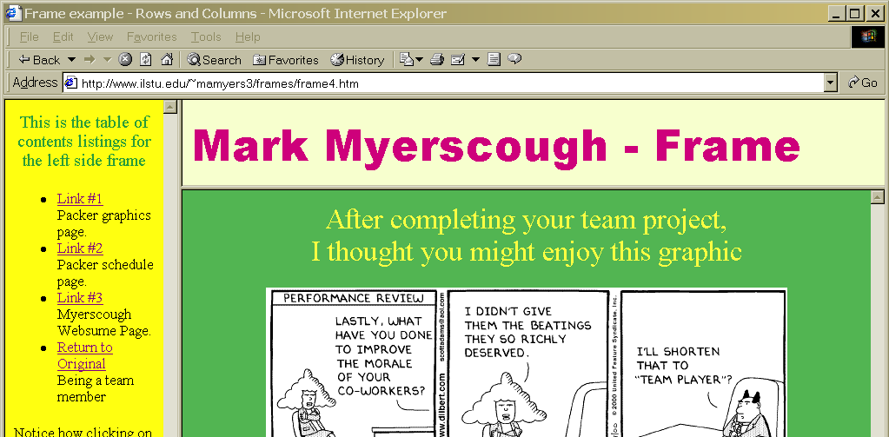
A row and column example

